Slide 1




Slide 2

Ratio & Proportion

Slide 3

Test time on : Cryptarithmetic
QR CODE:

Slide 4
Ratio
A ratio is a relationship between two numbers indicating how many times the first number contains the second.
For example, if a bowl of fruit contains eight oranges and six lemons, then the ratio of oranges to lemons is eight to six (that is, 8∶6, which is equivalent to the ratio 4∶3).

Slide 5
Proportion
A proportion is simply a statement that two ratios are equal. It can be written in two ways: as two equal fractions a/b = c/d; or using a colon, a:b = c:d. ...
In problems involving proportions, we can use cross products to test whether two ratios are equal and form a proportion.
A proportion is an equation with a ratio on each side. It is a statement that two ratios are equal. 3/4 = 6/8 is an example of a proportion.

Slide 6
Proportion
Now, let us assume that, in proportion, the two ratios are a:b & c:d.
The two terms ‘b’ and ‘c’ are called ‘means or mean term,’
whereas the terms ‘a’ and ‘d’ are known as ‘extremes or extreme terms.’
a/b = c/d or a : b :: c : d

Slide 7
Formula
If u/v = x/y, then uy = vx
If u/v = x/y, then u/x = v/y
If u/v = x/y, then v/u = y/x
If u/v = x/y, then (u+v)/v = (x+y)/y
If u/v = x/y, then (u-v)/v = (x-y)/y

Slide 8
Formula
If u/v = x/y, then (u+v)/ (u-v) = (x+y)/(x-y),
which is known as componendo -Dividendo Rule
If u/v = v/x, then u/x = u²/v²
If u/v = x/y, then u = x and v =y
If a/(b+c) = b/(c+a) = c/(a+b) and a+b+ c ≠0, then a =b = c

Slide 9
Question: 01
Are the ratios 4:5 and 8:10 said to be in Proportion?
A. YES
B. NO
Answer: A

Slide 10
Explanation: 01
4:5= 4/5 = 0.8 and 8: 10= 8/10= 0.8
Since both the ratios are equal, they are said to be in proportion.

Slide 11
Question: 02
Are the two ratios 8:10 and 7:10 in proportion?
A. YES
B. NO
Answer: B

Slide 12
Explanation: 02
8:10= 8/10= 0.8 and 7:10= 7/10= 0.7
Since both the ratios are not equal, they are not in proportion.

Slide 13
Question: 03
Given ratios are: a:b = 2:3, b:c = 5:2, c:d = 1:4 Find a: b: c:d.
A. 10:15:6:24
B. 10:6:15:24
C. 6:15:10:24
D. 24:6:10:15
Answer: A

Slide 14
Explanation: 03
Multiplying the first ratio by 5, second by 3 and third by 6, we have
a:b = 10: 15
b:c = 15 : 6
c:d = 6 : 24
In the ratio’s above, all the mean terms are equal, thus
a:b:c:d = 10:15:6:24

Slide 15
Question: 04
Divide Rs. 90 in ratio 1:2 between Ram and Karan.
A. Rs.30 and Rs.60
B. Rs.60 and Rs.30
C. Rs.45 and Rs.45
D. Rs.80 and Rs.10
Answer: A

Slide 16
Explanation: 04
There are two parts, 1 and 2, the sum of which is 3 parts. Hence among the 3 parts, Karan gets 2 and Ram gets 1.
Therefore for 90 Rs (considered equivalent to 3 parts here)
Karan’s share = 2/3 ×90 = Rs.60
Ram’s share = 1/3 ×90 = Rs.30

Slide 17
Question: 05
Two numbers are respectively 20% and 50% more than a third number.The ratio of the two numbers is ________.
A. 5:4
B. 4:5
C. 6:7
D. 7:6
Answer: B

Slide 18

Explanation: 05
Let the third number be x.
Then, first number=120% of x=120x/100=6x/5
Second number =150% of x=150x/100=3x/2
Ratio of first two numbers=

Slide 19
Question: 06
A sum of money is to be distributed among A, B, C, D in the proportion of
5 : 2 : 4 : 3. If C gets Rs. 1000 more than D, what is B's share?
A. Rs.500
B. Rs.1500
C. Rs.2000
D. None of these
Answer: C

Slide 20
Explanation: 06
Let the shares of A, B, C and D be Rs.5x,Rs.2x,Rs.4x,Rs.3x
Then 4x-3x=1000
X=1000
So.B’s share=2*1000=2000

Slide 21
Question: 07
Seats for Mathematics, Physics and Biology in a school are in the ratio 5 : 7 : 8. There is a proposal to increase these seats by 40%, 50% and 75% respectively. What will be the ratio of increased seats?
A. 2:3:4
B. 6:7:8
C. 6:8:9
D. None of These
Answer: A

Slide 22
Explanation: 07
Originally, let the number of seats for Mathematics, Physics and Biology be5x,7x and 8x respectively.
Number of increased seats are (140% of 5x) ,(150% of 7x) and (175% of 8x)
(140/100 x 5x),(150/100 x 7x),(175/100 x 8x)
7x.21x/2 and 14x
The required ratio is 7x:21x/2:14x
14x:21x:28x=2:3:4

Slide 23
Question: 08
In a mixture 60 litres, the ratio of milk and water is 2 : 1. If this ratio is to be 1 : 2, then the quantity of water to be further added is __________.
A. 20litres
B. 30litres
C. 40litres
D. 60litres
Answer: D

Slide 24
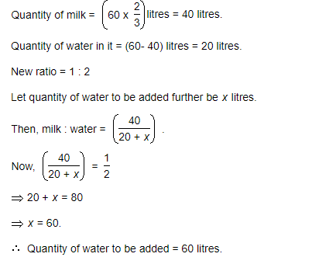
Explanation: 08

Slide 25
Question: 09
The ratio of the number of boys and girls in a college is 7 : 8. If the percentage increase in the number of boys and girls be 20% and 10% respectively, what will be the new ratio?
A. 8:9
B. 17:18
C. 21:22
D. Cannot be determined
Answer: C

Slide 26
Explanation: 09
Originally, let the number of boys and girls in the college be 7x and 8x .
Their increased number is (120% of 7x),(110% of 8x)
(120/100 x7x) and (110/100 x 8x)
(42x/5) and (44x/5)
The required ratio is (42x/5:44x/5)=(21:22)

Slide 27
Question: 10
Salaries of Ravi and Summit are in the ratio 2 : 3. If the salary of each is increased by Rs. 4000, the new ratio becomes 40 : 57. What is Summit's salary?
A. Rs. 17,000
B. Rs. 20,000
C. Rs. 25,500
D. Rs. 38,000
Answer: D

Slide 28
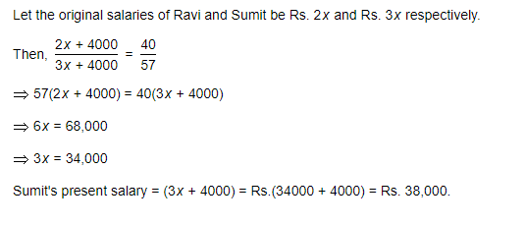
Explanation: 10

Slide 29
Question: 11
The sum of three numbers is 98. If the ratio of the first to second is 2 :3 and that of the second to the third is 5 : 8, then the second number is __________.
A. 20
B. 30
C. 48
D. 58
Answer:B

Slide 30
Explanation: 11
Let the three parts be A, B, C. Then,
A : B = 2 : 3 and B : C = 5 : 8 =(5 x 3/5) :(8 x 3/5)=(3:24/5)
A:B:C = 2:3:24/5 = 10:15:24
B=(98 x 15/49)=30

Slide 31
Question: 12
The salaries A, B, C are in the ratio 2 : 3 : 5. If the increments of 15%, 10% and 20% are allowed respectively in their salaries, then what will be new ratio of their salaries?
A. 3:3:10
B. 10:11:20
C. 23:33:60
D. Cannot be determined
Answer: C

Slide 32
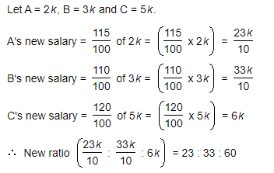
Explanation: 12

Slide 33
Question: 13
If 40% of a number is equal to two-third of another number, what is the ratio of first number to the second number?
A. 2:5
B. 3:7
C. 5:3
D. 7:3
Answer: C

Slide 34
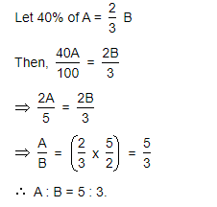
Explanation: 13

Slide 35
Question: 14
The fourth proportional to 5, 8, 15 is ______.
18
24
19
20
Answer: B

Slide 36
Explanation: 14
Let the fourth proportional to 5, 8, 15 be x
Then, 5:8:15:x
5x=(8x15)
X=24
Ans:24

Slide 37
Question: 15
Two number are in the ratio 3 : 5. If 9 is subtracted from each, the new numbers are in the ratio 12 : 23. The smaller number is ________.
27
33
49
55
Answer: B

Slide 38
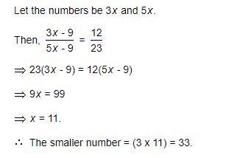
Explanation: 14

Slide 39

https://learn.codemithra.com

Slide 40




THANK YOU
+91 78150 95095
codemithra@ethnus.com
www.codemithra.com

